Slide 1
Email Migration
What you need to know

Slide 2
How Do I login?
Let’s take a look at some friends.
We have John Doe, a student at Gupton-Jones College. His email is jdoe@gupton-jones.edu.
We have Abby Doe, a student at Dallas Institute. Her email is adoe@dallasinstitute.edu.
And we have Geo Doe, a student at Mid-America College. Her email is gdoe@mid-America.edu

Slide 3
How do I login?
Last week, they logged in to their emails like this: John Doe jdoe@gupton-jones.edu Abby Doe adoe@dallasinstitute.edu Geo Doe gdoe@mid-America.edu
After the migration, they will keep their same username but will now log in like this: John Doe jdoe@pierce.edu Abby Doe adoe@pierce.edu Geo Doe gdoe@pierce.edu

Slide 4
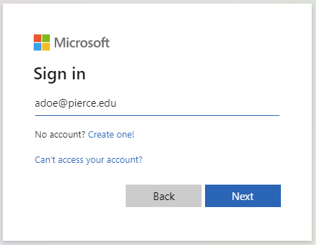
What is changing?
Log in at login.microsoftonline.com
Just like Abby, you will now log in with the same username, but change the last part to pierce.edu
adoe@dallasinstitute.edu adoe@pierce.edu

Slide 5
What else is changing?
Your student email address will have stu. added to it. It is changing from: Old:
gdoe@mid-america.edu you@campus.edu
To new(students): gdoe@stu.mid-america.edu you@stu.campus.edu
Faculty: no change gdoe@mid-america.edu you@campus.edu

Slide 6
Why change the email address?
Students’ emails are going to have stu. added so it is easier to determine whether an email is from a student or faculty.

Slide 7
Do I need to tell people my email changed?
John has a dog named Claudius the Great, but calls him Spot for short. His sister calls the dog Goodboy.
Spot and Goodboy are Aliases for the same dog – whether Claudius the Great, Spot, or Goodboy get a treat, the same dog gets the treat.

Slide 8
Do I need to tell people my email changed?
Just like Claudius the Great, your new account is you@pierce.edu. Your new account has Aliases too.
If anyone sends an email to your old email, now an Alias (you@dallasinstitute.edu, you@mid-America.edu, you@gupton-jones.edu), you will get it in your you@pierce.edu account.
No need to notify anyone your email has changed.

Slide 9
How can people reach me, a student?
People can send an email directly to your @pierce account or any of your aliases. You will see emails sent to any supported alias in your @pierce account. Gupton Jones Students: username@gupton-jones.edu (going away in October-November) username@stu.gupton-jones.edu username@pierce.edu
Mid-America Students: username@mid-america.edu (going away in October-November) username@stu.mid-america.edu username@pierce.edu Dallas Students: username@dallasinstitute.edu (going away in October-November) username@stu.dallasinstitute.edu username@pierce.edu

Slide 10
How can people reach me, an instructor or staff?
People can send an email directly to your @pierce account or your alias. You will see emails sent to any supported alias in your @pierce account. Gupton Jones Campus: username@gupton-jones.edu username@pierce.edu
Mid-America Campus: username@mid-america.edu username@pierce.edu Dallas Institute Campus: username@dallasinstitute.edu username@pierce.edu

Slide 11
What email will people see when I send them an email?
If you are a student: People will see emails coming from you@stu.campus.edu
If you are an instructor or faculty:
People will see emails coming from
you@campus.edu

Slide 12
Troubleshooting & FAQs

Slide 13
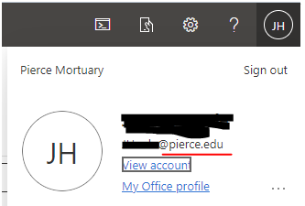
I’m not receiving emails anymore – help?
If you aren’t receiving any emails, log in at outlook.office.com/mail
At the very top right, click your initials:
When you click your initials, a drop-down will appear.
**If the text following the @ is NOT @pierce.edu, you need to log out and sign into your you@pierce.edu account.

Slide 14
How can I use Word, Powerpoint, and Excel?[For Students]
Students: These are supported only on the web and can be accessed by logging in to www.office.com and selecting them from the left sidebar:

Slide 15
I’m not receiving emails on my phone app. [for students]
Students: Student email can not be accessed via a mail app. To log into student email, open a browser (Safari, Chrome, Microsoft Edge, Brave, DuckDuckGo, etc) on your phone or computer and go to https://outlook.office.com/mail/
And log in with your @pierce.edu account.

Slide 16
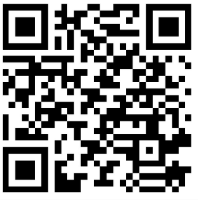
Where can I get help?
IT can be reached in a variety of ways:
Send an email to itsupport@wilbert.com -Include a good number to text you at.
Use the following link: https://bit.ly/3TYr03h
Scan this QR Code:

